Slide 1







Isogeometric Analysis of Thin Metal Sheets
Thesis Registration
14th November
Thesis Submission
14th May
IGA of single patch
15th January
IGA of multi-patch 15th March
NURBS geometry refinement
15th December
IGA of single trimmed patch
15th February
IGA of multi-trimmed patch
15th April
Biweekly reviews
Monthly reviews
Nov Dec Jan Feb March April May
So far…

Slide 2
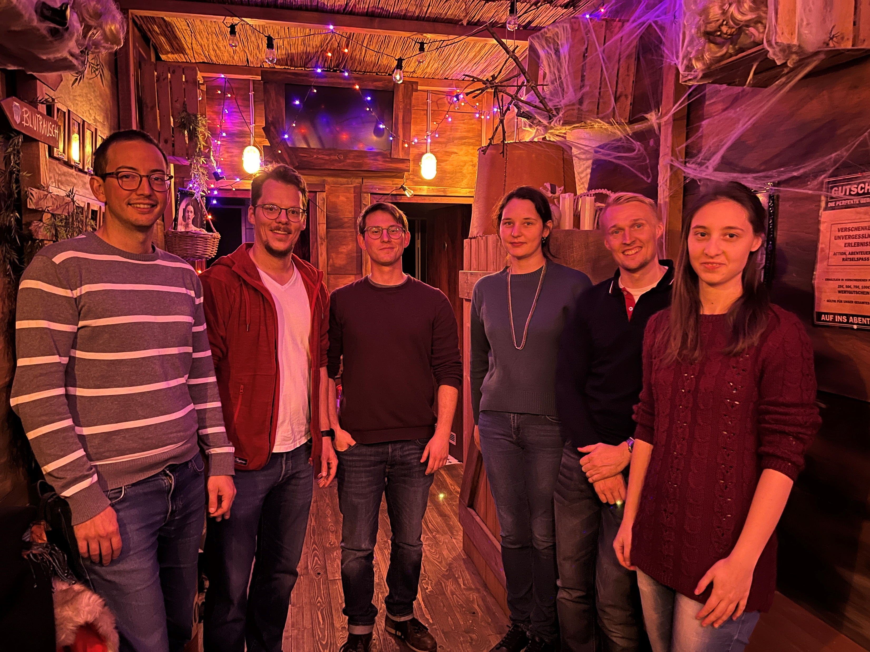
FLORIAN
BERNHARD
DIANNA
STEFAN
STEPHAN
STANKA

